Slide 1
PROJECT 15
Courier Parcel Booking and Tracking Management System
Design and Implementation of a Database Management System
Akshaya | Srinidhi | Sahasra
DBMS Course Project - Final Presentation
Notes:
Akshaya introduces the team and the project title (10 seconds).

Slide 2
Problem Description
Problem: Manual registers cannot give reliable end-to-end tracking of parcel booking, routing, scanning, delivery and payment.
Objectives
Scope
Intended Users
Centralised parcel, booking and payment records
Real-time tracking via scan events
Enforce business rules in the database
Booking, charge calculation, routing
Agent assignment, delivery and failed attempts
Reports: delayed shipments, branch load, revenue
Customers
Branch staff
Delivery agents
Admin / management
Notes:
Akshaya: state the problem, objectives, scope and users in about one minute.

Slide 3
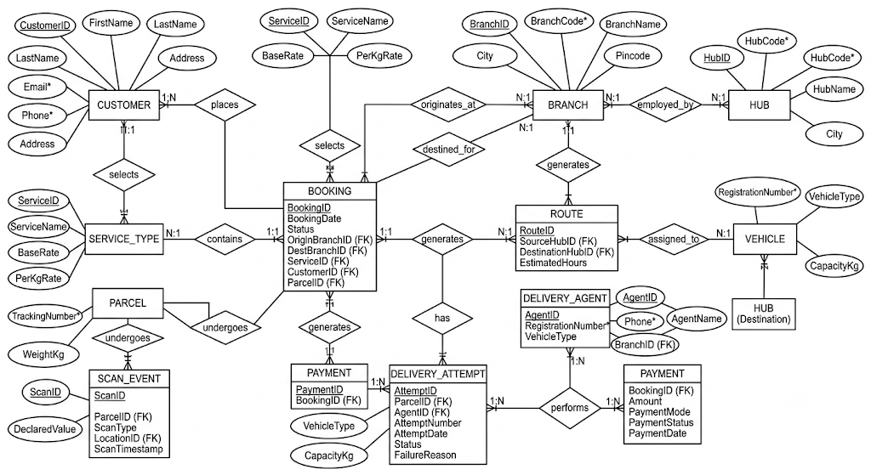
ER Diagram
Entities: Customer, Branch, Hub, Service Type, Parcel, Booking, Route, Vehicle, Delivery Agent, Scan Event, Delivery Attempt, Payment
Notes:
Srinidhi: walk through entities, keys, relationships, cardinality (1:N, N:1, 1:1) and participation.

Slide 4
Relational Schema and Normalization (3NF)
Table | Primary key | Foreign keys
CUSTOMER | CustomerID | -
BRANCH | BranchID | HubID
HUB | HubID | -
SERVICE_TYPE | ServiceID | -
PARCEL | ParcelID | -
BOOKING | BookingID | CustomerID, ParcelID, ServiceID, Origin/DestBranchID
ROUTE / VEHICLE | RouteID / VehicleID | Source/DestHubID, VehicleID
DELIVERY_AGENT | AgentID | BranchID
SCAN_EVENT | ScanID | ParcelID, LocationID
DELIVERY_ATTEMPT | AttemptID | ParcelID, AgentID
PAYMENT | PaymentID | BookingID
Normalization
1NF: atomic values, no repeating groups
2NF: no partial dependency on composite keys
3NF: no transitive dependency; service rates in SERVICE_TYPE, branch details in BRANCH
Lookup data split into its own tables to avoid redundancy
Notes:
Srinidhi: show how the ER model maps to tables and why every table is in 3NF.

Slide 5
Normalization: 1NF and 2NF
Unnormalized (UNF): multi-valued ScanEvents
1NF: atomic values, key = (BookingID, ScanType)
BookingID | CustomerName | ServiceName | BaseRate | ScanEvents
B101 | Ravi | Express | 50 | Booked, In Transit, Delivered
B102 | Anu | Standard | 30 | Booked, In Transit
BookingID (PK) | ScanType (PK) | CustomerName | ServiceName | BaseRate
B101 | Booked | Ravi | Express | 50
B101 | In Transit | Ravi | Express | 50
B101 | Delivered | Ravi | Express | 50
B102 | Booked | Anu | Standard | 30
B102 | In Transit | Anu | Standard | 30
2NF: partial dependency removed (BookingID -> CustomerName, ServiceName, BaseRate)
BookingID (PK) | CustomerName | ServiceName | BaseRate
B101 | Ravi | Express | 50
B102 | Anu | Standard | 30
BookingID (PK, FK) | ScanType (PK)
B101 | Booked
B101 | In Transit
B101 | Delivered
B102 | Booked
B102 | In Transit
BOOKING
SCAN_EVENT
Notes:
Srinidhi: UNF has a multi-valued ScanEvents column. 1NF makes every value atomic (one row per scan). 2NF removes partial dependency: CustomerName, ServiceName and BaseRate depend only on BookingID, not on the full key (BookingID, ScanType).

Slide 6
Normalization: 3NF
2NF BOOKING: transitive dependencies exist
BookingID (PK) | CustomerID | CustomerName | ServiceID | ServiceName | BaseRate
B101 | C01 | Ravi | S1 | Express | 50
B102 | C02 | Anu | S2 | Standard | 30
BookingID -> CustomerID -> CustomerName and BookingID -> ServiceID -> ServiceName, BaseRate
3NF: every non-key attribute depends only on its table's key
CUSTOMER
SERVICE_TYPE
BOOKING
CustomerID (PK) | CustomerName
C01 | Ravi
C02 | Anu
ServiceID (PK) | ServiceName | BaseRate
S1 | Express | 50
S2 | Standard | 30
BookingID (PK) | CustomerID (FK) | ServiceID (FK)
B101 | C01 | S1
B102 | C02 | S2
SCAN_EVENT (BookingID, ScanType) is already in 3NF. No redundancy remains, and updates, inserts and deletes no longer cause anomalies.
Notes:
Srinidhi: in the 2NF BOOKING table, CustomerName depends on CustomerID and ServiceName/BaseRate depend on ServiceID, which are non-key attributes (transitive dependencies). Split them into CUSTOMER and SERVICE_TYPE so every non-key attribute depends only on the key.

Slide 7
Database and Table Creation
Parent tables
Child table with constraints
CREATE DATABASE courier_db;
USE courier_db;
CREATE TABLE CUSTOMER (
CustomerID INT PRIMARY KEY
AUTO_INCREMENT,
FirstName VARCHAR(50) NOT NULL,
Email VARCHAR(100) UNIQUE,
Phone VARCHAR(15) UNIQUE
);
CREATE TABLE SERVICE_TYPE (
ServiceID INT PRIMARY KEY
AUTO_INCREMENT,
ServiceName VARCHAR(30) NOT NULL,
BaseRate DECIMAL(8,2)
CHECK (BaseRate > 0)
);
CREATE TABLE BOOKING (
BookingID INT PRIMARY KEY
AUTO_INCREMENT,
BookingDate DATE NOT NULL,
Status VARCHAR(20)
DEFAULT 'Booked',
WeightKg DECIMAL(6,2)
CHECK (WeightKg > 0),
CustomerID INT NOT NULL,
ServiceID INT NOT NULL,
FOREIGN KEY (CustomerID)
REFERENCES CUSTOMER(CustomerID),
FOREIGN KEY (ServiceID)
REFERENCES SERVICE_TYPE(ServiceID)
);
Notes:
Sahasra: run these live in MySQL. Point out PRIMARY KEY, FOREIGN KEY, UNIQUE, NOT NULL, CHECK and DEFAULT. Full script is in the .sql file.

Slide 8
Inserting Records
CUSTOMER (5 records)
BOOKING (5 records)
INSERT INTO CUSTOMER
(FirstName, Email, Phone)
VALUES
('Ravi','ravi@mail.com','9876500001'),
('Anu','anu@mail.com','9876500002'),
('Meena','meena@mail.com','9876500003'),
('Kiran','kiran@mail.com','9876500004'),
('Priya','priya@mail.com','9876500005');
INSERT INTO BOOKING
(BookingDate, WeightKg,
CustomerID, ServiceID)
VALUES
('2026-10-01', 2.50, 1, 1),
('2026-10-01', 1.20, 2, 2),
('2026-10-02', 5.00, 3, 1),
('2026-10-02', 0.80, 4, 3),
('2026-10-03', 3.40, 5, 2);
The same pattern is used for every other table (minimum 5 records each). The complete script is in the .sql file.
Notes:
Sahasra: insert at least 5 records per table. Show SELECT * after inserting to prove the data is stored.

Slide 9
SELECT Queries: Join and Aggregate
1. Join: booking with customer and service
SELECT b.BookingID, c.FirstName, s.ServiceName, b.Status
FROM BOOKING b
JOIN CUSTOMER c ON b.CustomerID = c.CustomerID
JOIN SERVICE_TYPE s ON b.ServiceID = s.ServiceID;
2. Aggregate: bookings and revenue per branch
SELECT br.BranchName, COUNT(b.BookingID) AS Bookings,
SUM(p.Amount) AS Revenue
FROM BOOKING b
JOIN BRANCH br ON b.OriginBranchID = br.BranchID
JOIN PAYMENT p ON p.BookingID = b.BookingID
GROUP BY br.BranchName
ORDER BY Revenue DESC;
Notes:
Sahasra: first query shows a 3-table JOIN, second shows COUNT/SUM with GROUP BY and ORDER BY.

Slide 10
User Interface Demo
1
2
3
4
Insert
View
Delete
Verify
Book a parcel, charge is calculated
Track parcel and scan history
Remove a record, validated
Show each change in MySQL
Python / Java front-end connected to MySQL | input validation | screenshots of every screen (before and after) in the Presentation folder
Notes:
Akshaya: live demo. Insert a booking, view it, delete a record; after each action show the change in MySQL.

Slide 11
Thank You
Questions?
Notes:
Any member may be asked about any part of the project - everyone should know the whole thing.

